Slide 1
Advanced Algorithm Assignment 1 Nearest Neighbor Greedy Method
12032189
Yuxi Liu

Slide 2
context
Model Assumpation
Example
Solution Quality

Slide 3

Model Assumpation
We need to complete the TSP problem with 10 cities.
Each city is fully connected.
We record the European distance between city i and city j as $cost\left(i,j\right)$, and $cost\left(i,j\right)=cost(j,i)$

Slide 4
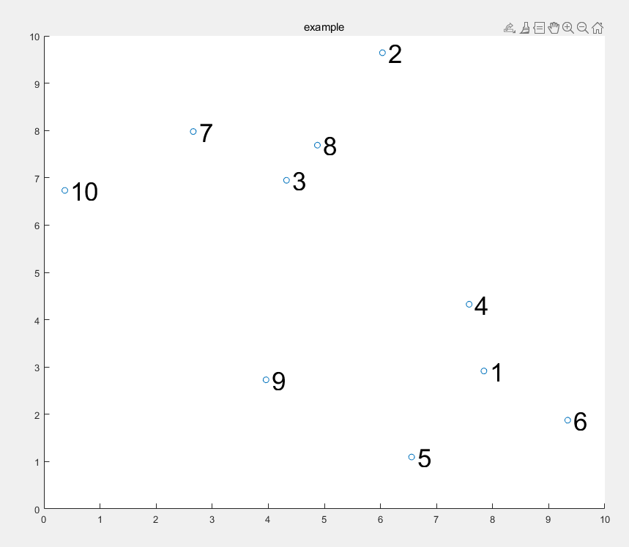
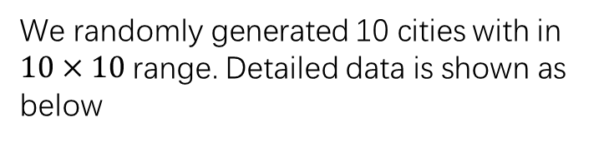
Model Assumpation
We randomly generated 10 cities with in $10×10$range. Detailed data is shown as below
num | x | y
1 | 7.844279 | 2.915703
2 | 6.035334 | 9.644227
3 | 4.32485 | 6.947522
4 | 7.580993 | 4.326423
5 | 6.55498 | 1.097551
6 | 9.337598 | 1.874608
7 | 2.661788 | 7.978303
8 | 4.876038 | 7.689583
9 | 3.960067 | 2.729388
10 | 0.372346 | 6.732949

Slide 5
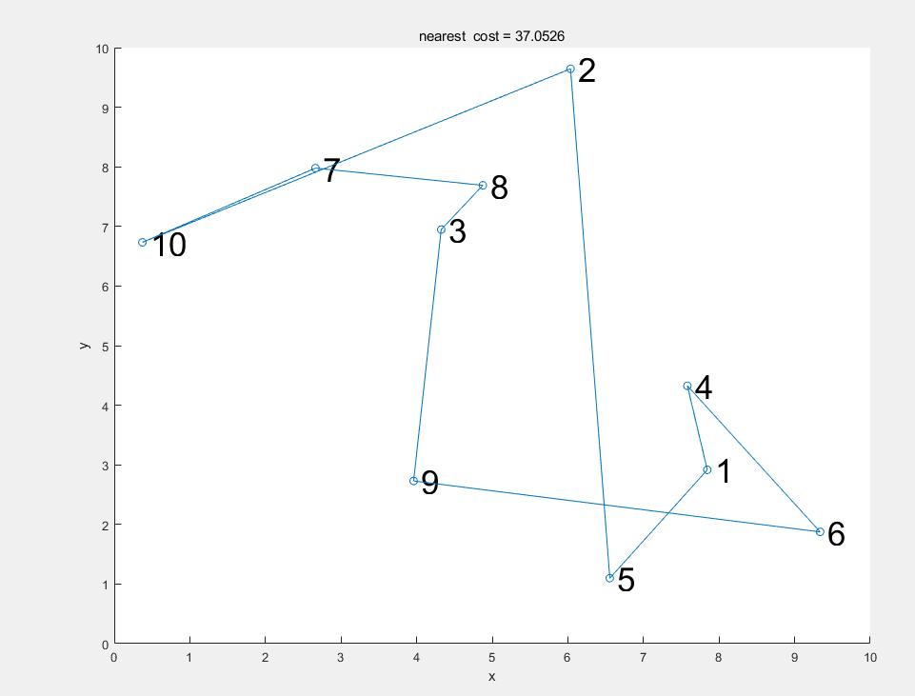
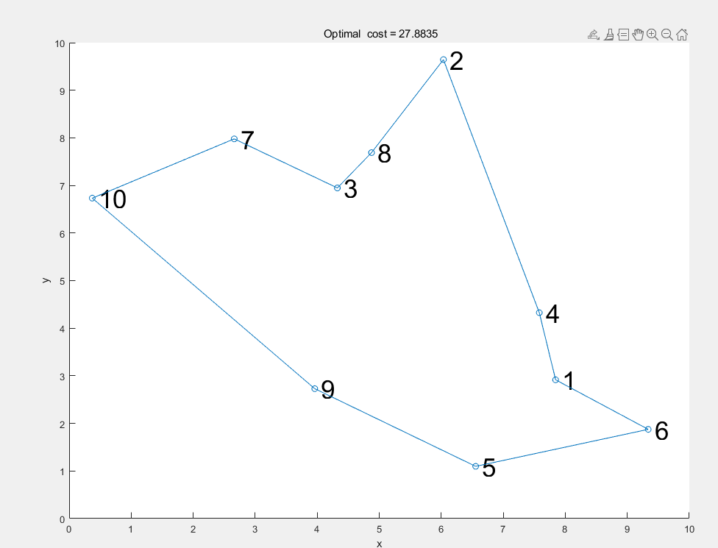

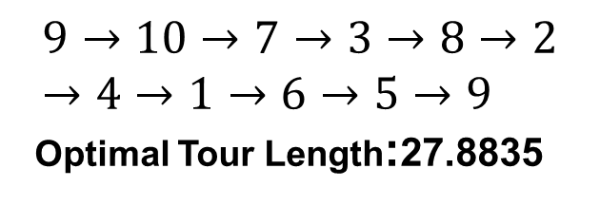
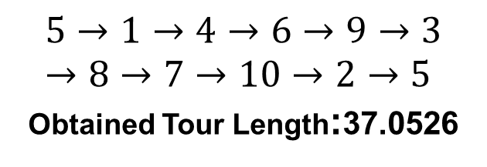
Model Assumpation
Nearest neighbor greedy algorithm
(start by a random city)
Global optimal solution
$$5→1→4→6→9→3→8→7→10→2→5$$
Obtained Tour Length:37.0526
$$9→10→7→3→8→2→4→1→6→5→9$$
Optimal Tour Length:27.8835
$SQ$ = 1.3288

Slide 6
Solution Quality
Solution Quality
We set each city as the starting city and the nearest neighbor greedy algorithm to calculate Tour Length,result as below.
We found the nearest neighbor greedy algorithm may reach the optimal solution,but the time cost much smaller than the Optimal which we use full array method.

Slide 7
Solution Quality
Solution Quality

Slide 8
Thank you

